Slide 1




Ch 12 Prejudice: Interplay of Cognitive and Affective Biases
ANDlab social_cognition_seminar
Haiyan Wu

Slide 2



Slide 3
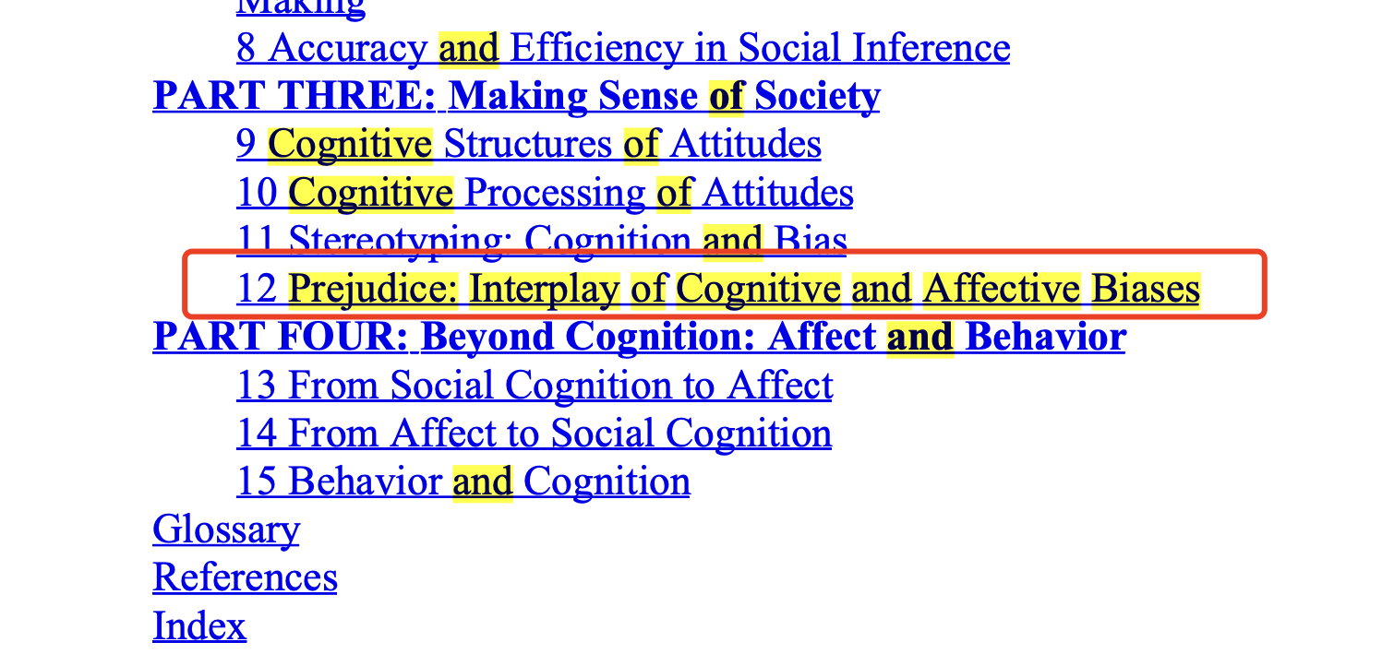

Slide 4
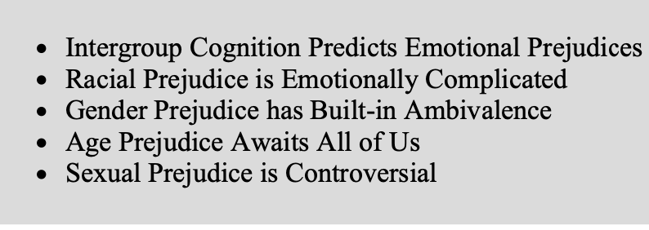
Structure

Slide 5
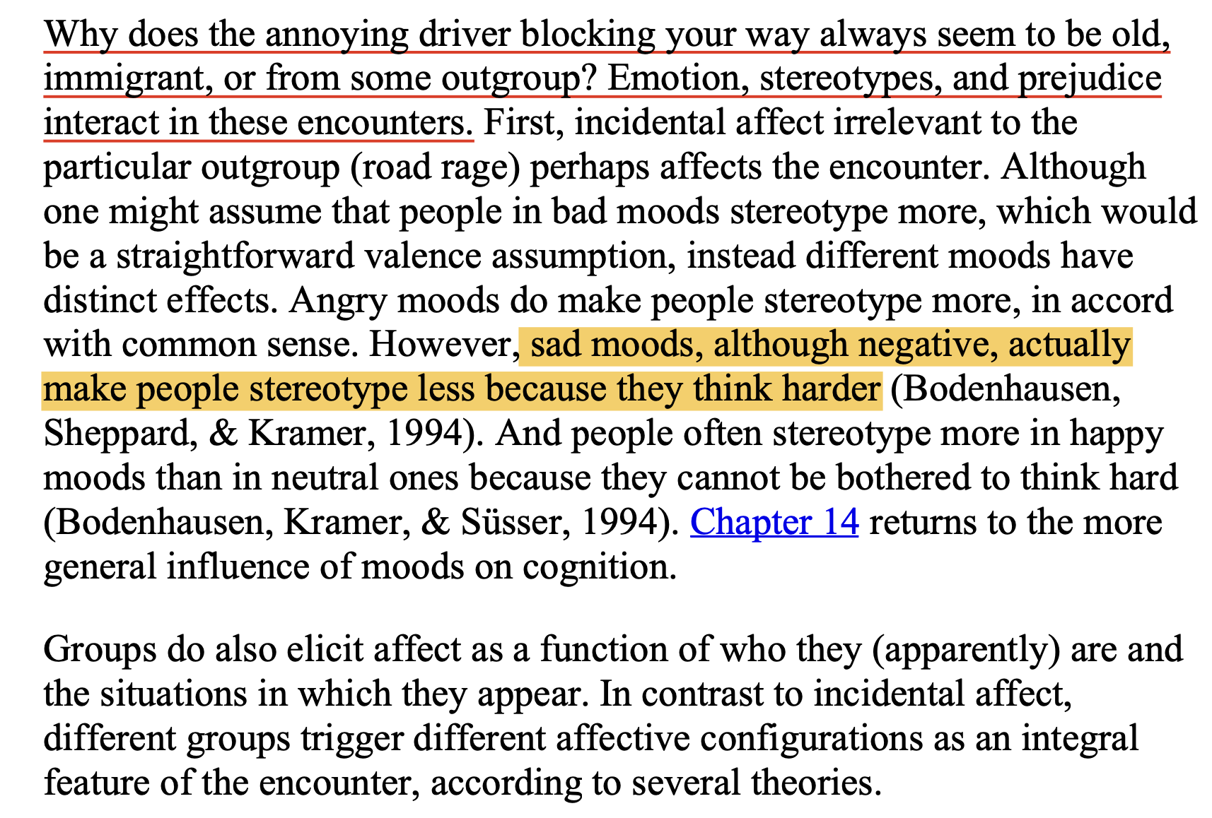
Intergroup Cognition Predicts Emotional Prejudices

Slide 6
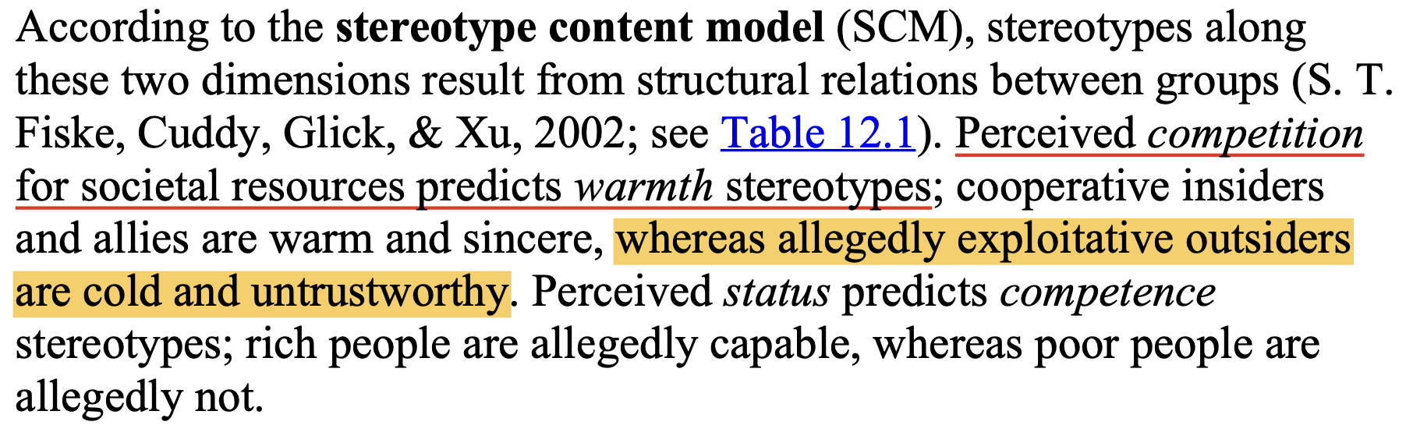
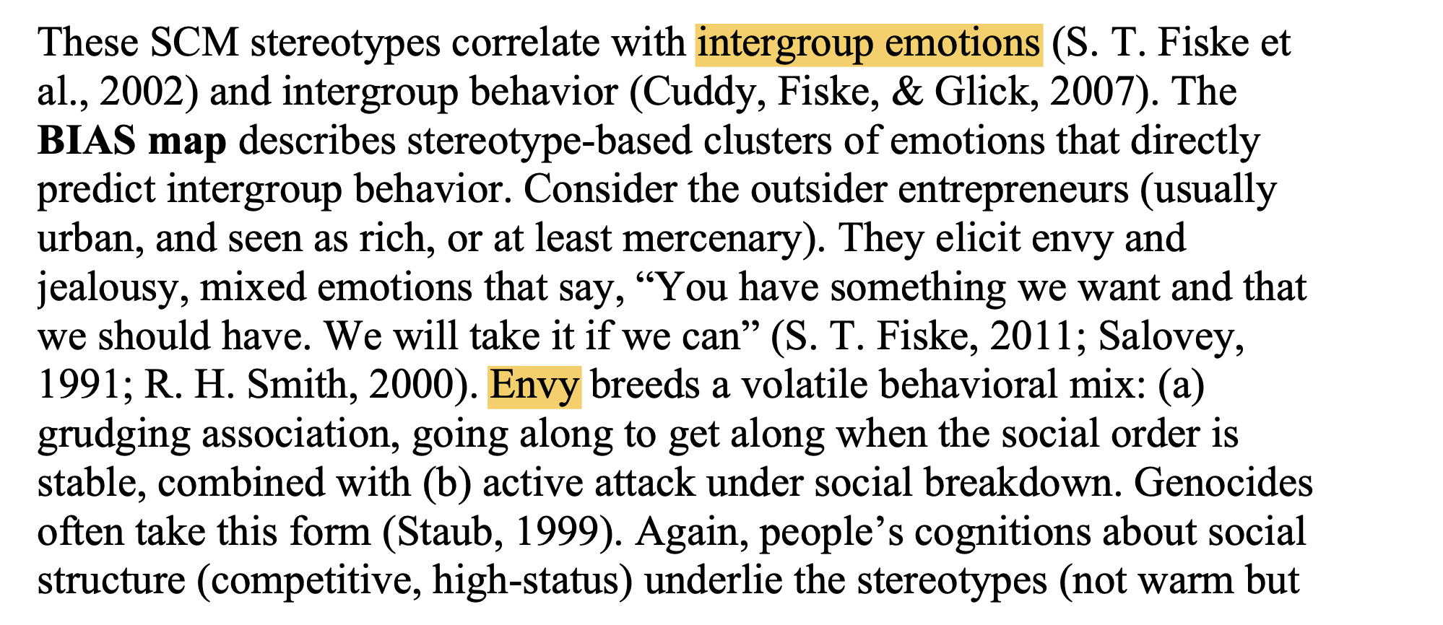
Stereotype Content Model

Slide 7
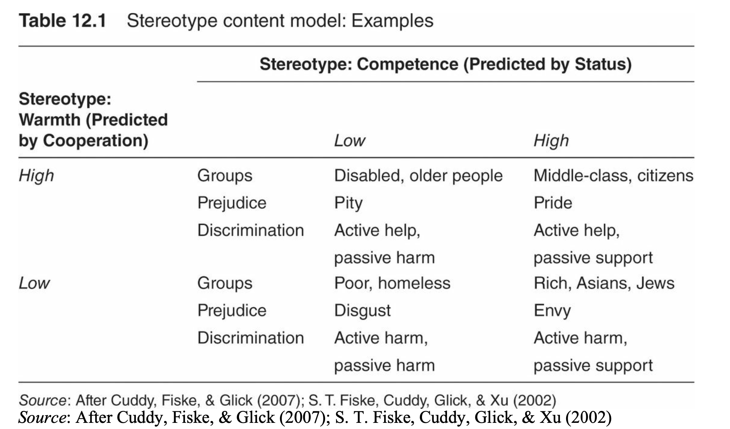
Intergroup Emotions Theory
people respond more quickly and accurately to traits that match their self- concept and their ingroup concept, compared to mismatches

Slide 8
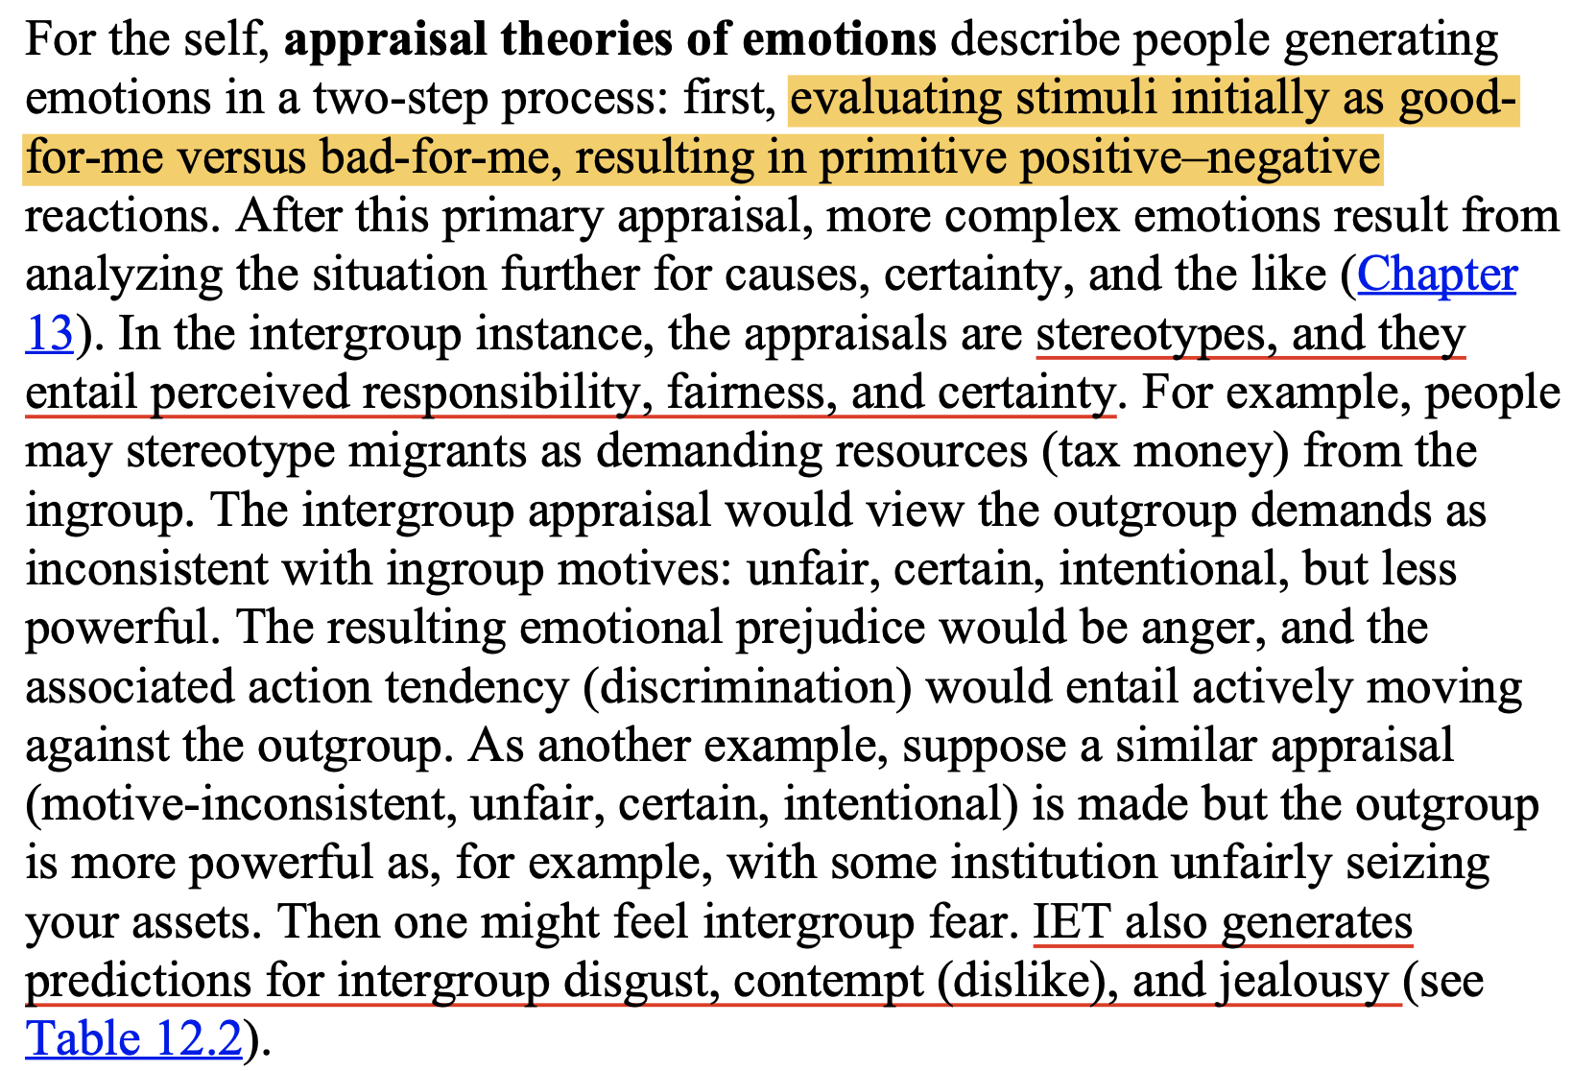
Intergroup Emotions Theory

Slide 9
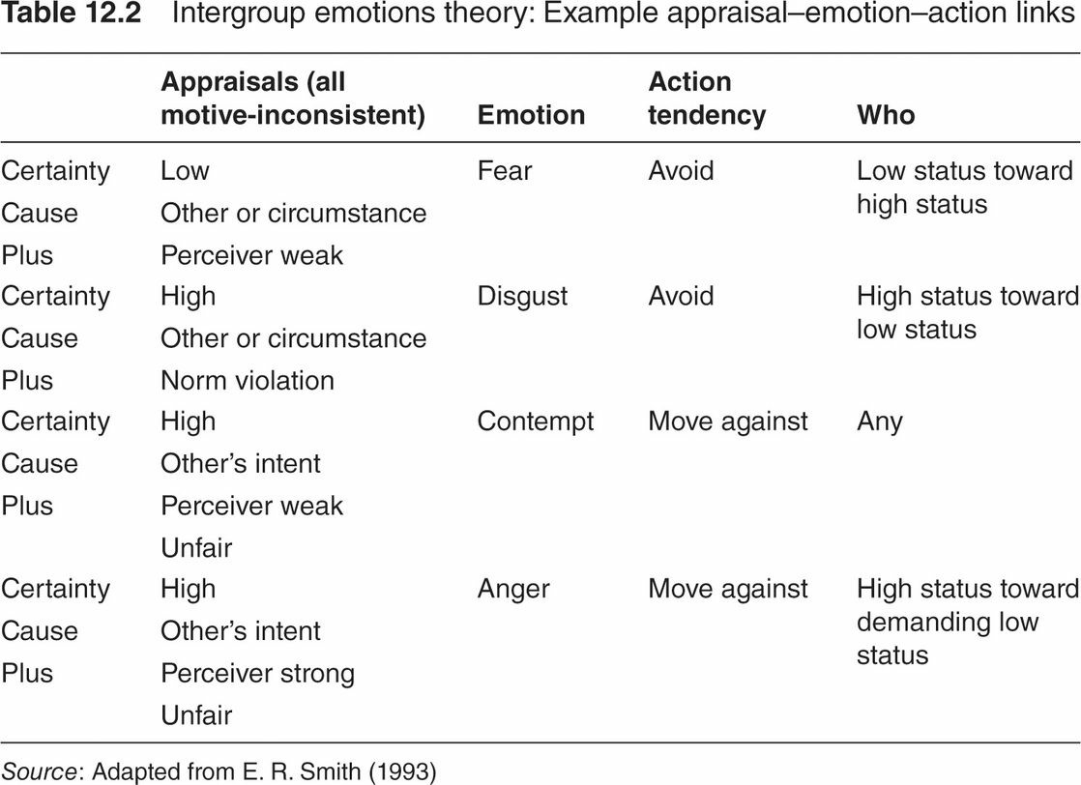
Intergroup Emotions Theory
IET conceptualizes prejudice as a specific intergroup emotion that comes from a specific appraisal (stereotype) and creates specific emotional action tendencies (discrimination).

Slide 10
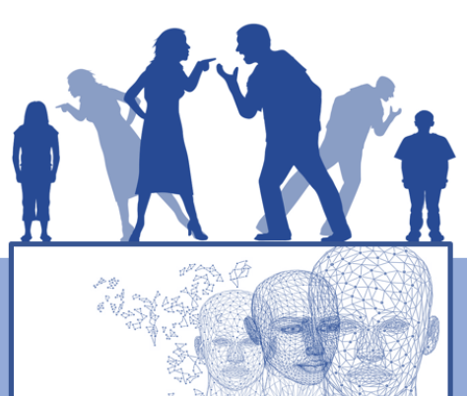
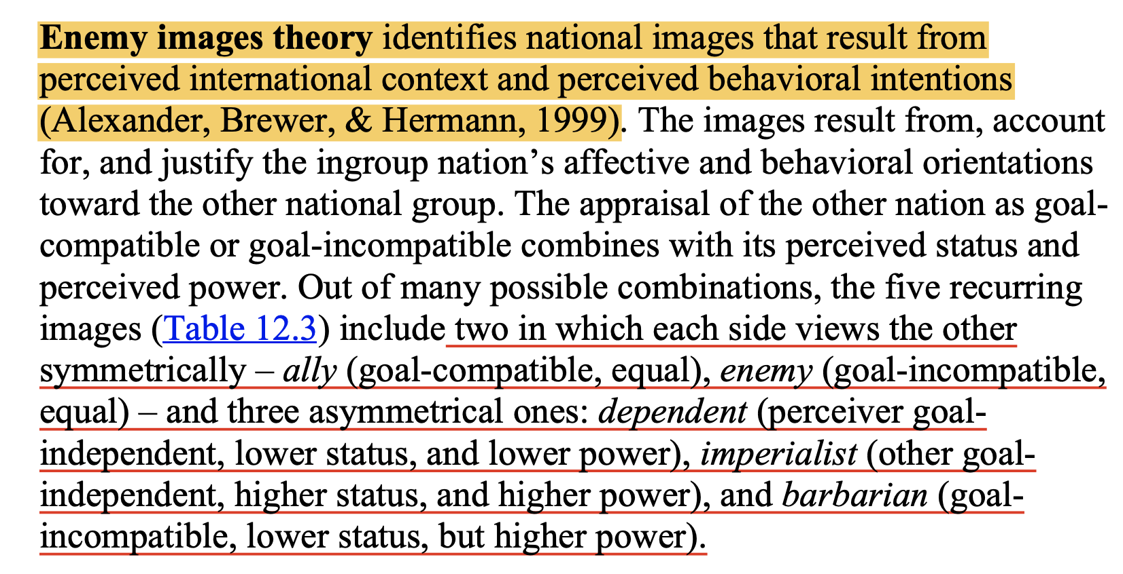
Image Theory
Enemy images theory identifies national images that result from perceived international context and perceived behavioral intentions (Alexander, Brewer, & Hermann, 1999)

Slide 11


Slide 12
“宇宙就是一座黑暗森林，每个文明都是带枪的猎人，像幽灵般潜行于林间，轻轻拨开挡路的树枝，竭力不让脚步发出一点儿声音，连呼吸都小心翼翼……他必须小心，因为林中到处都有与他一样潜行的猎人。如果他发现了别的生命，不管是不是猎人，不管是天使还是魔鬼，不管是娇嫩的婴儿还是步履蹒跚的老人，也不管是天仙的少女还是天神般的男孩，能做的只有一件事：开枪消灭之。在这片森林中，他人就是地狱，就是永恒的威胁，任何暴露自己存在的生命都将很快被消灭。”

Slide 13
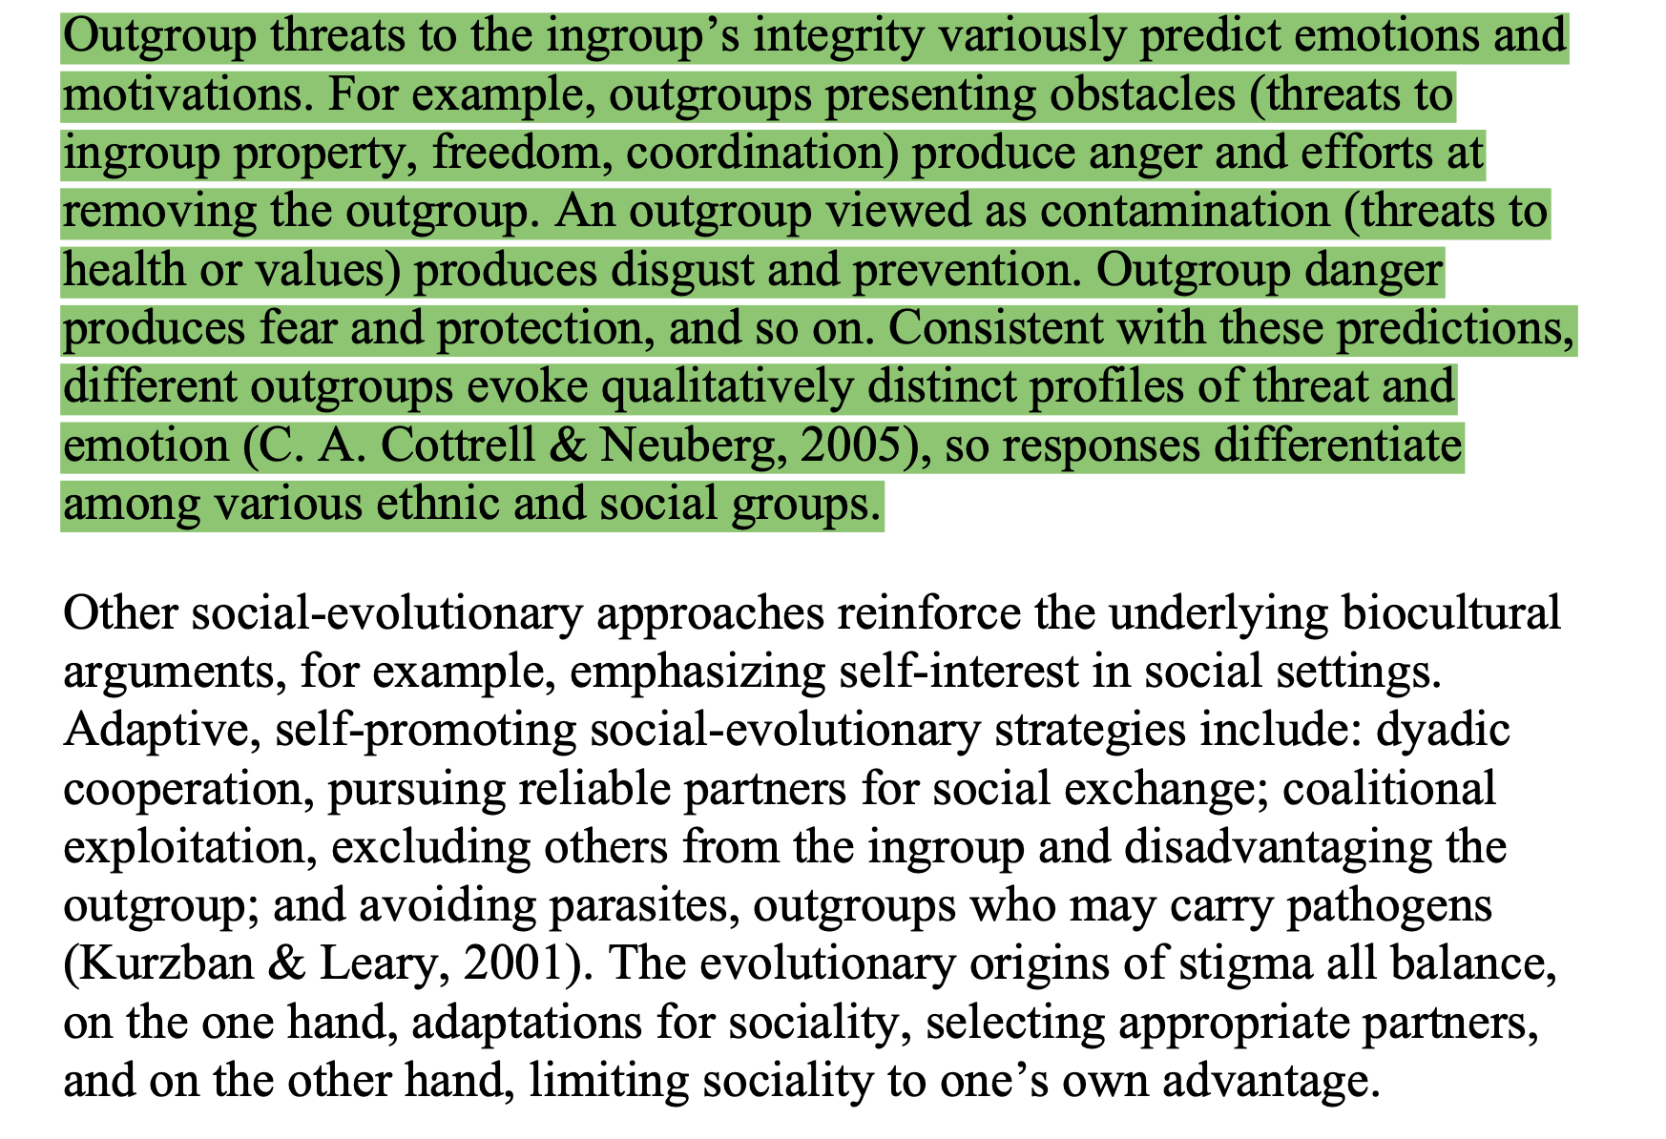
Biocultural Approach

Slide 14
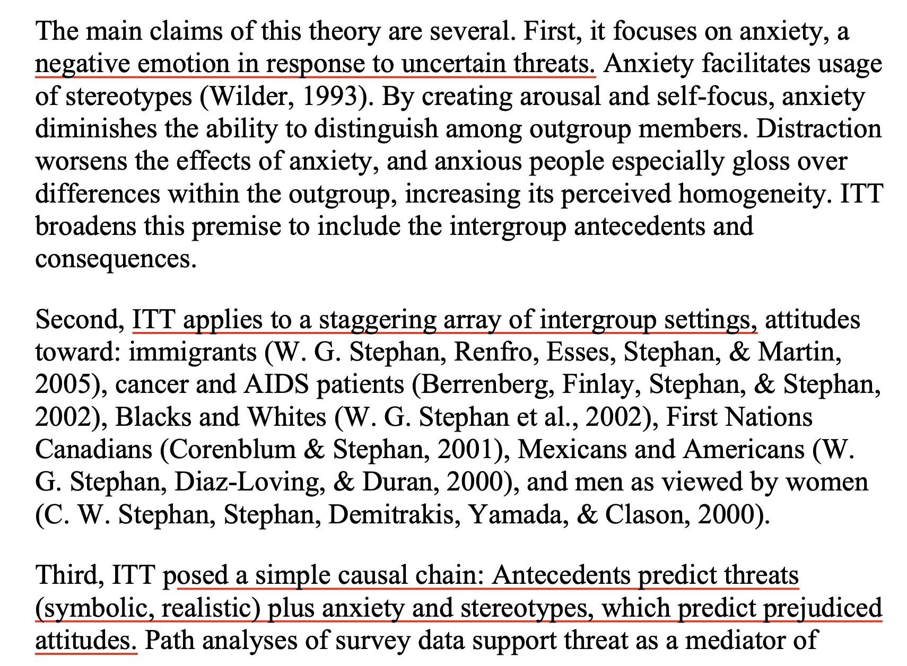
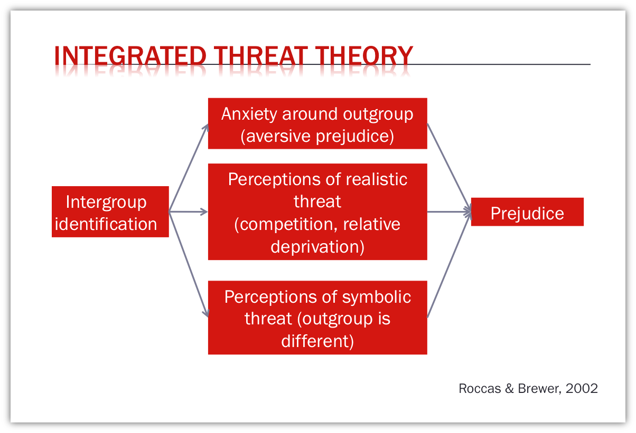
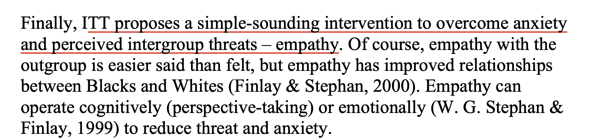
Anxiety: Integrated Threat Theory

Slide 15
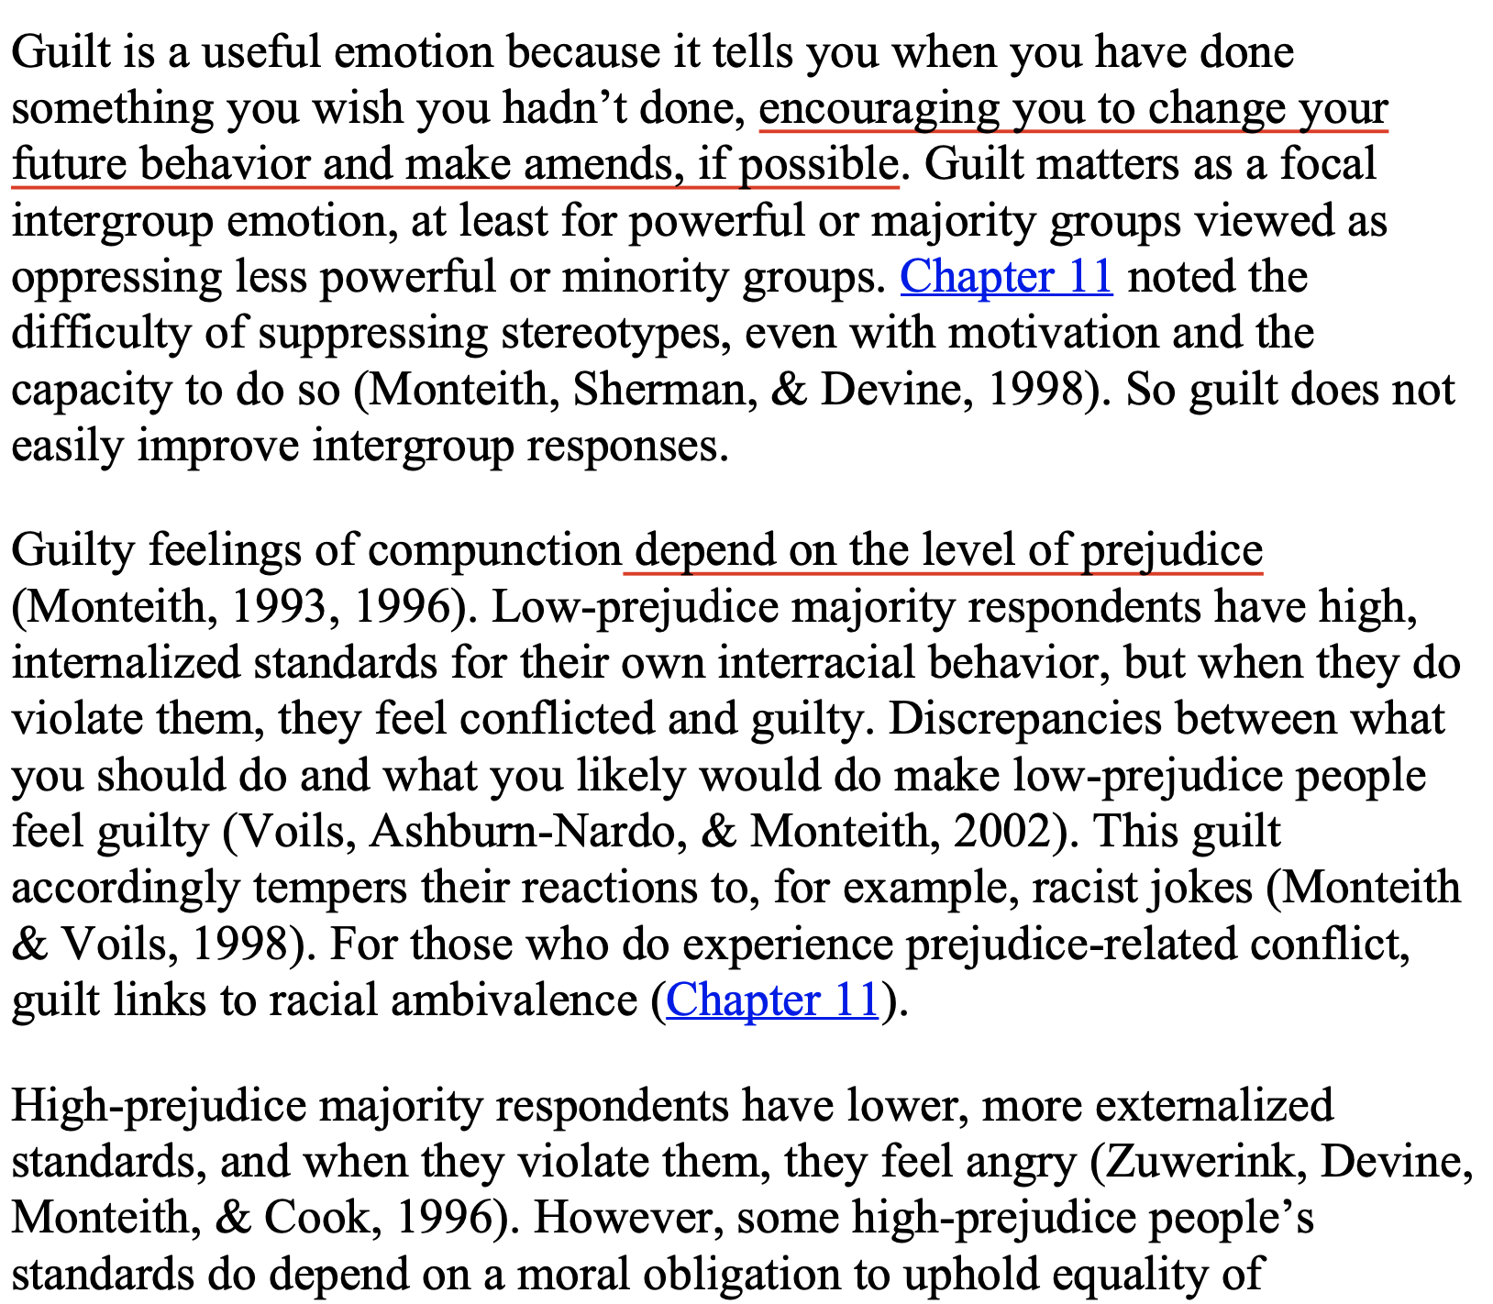
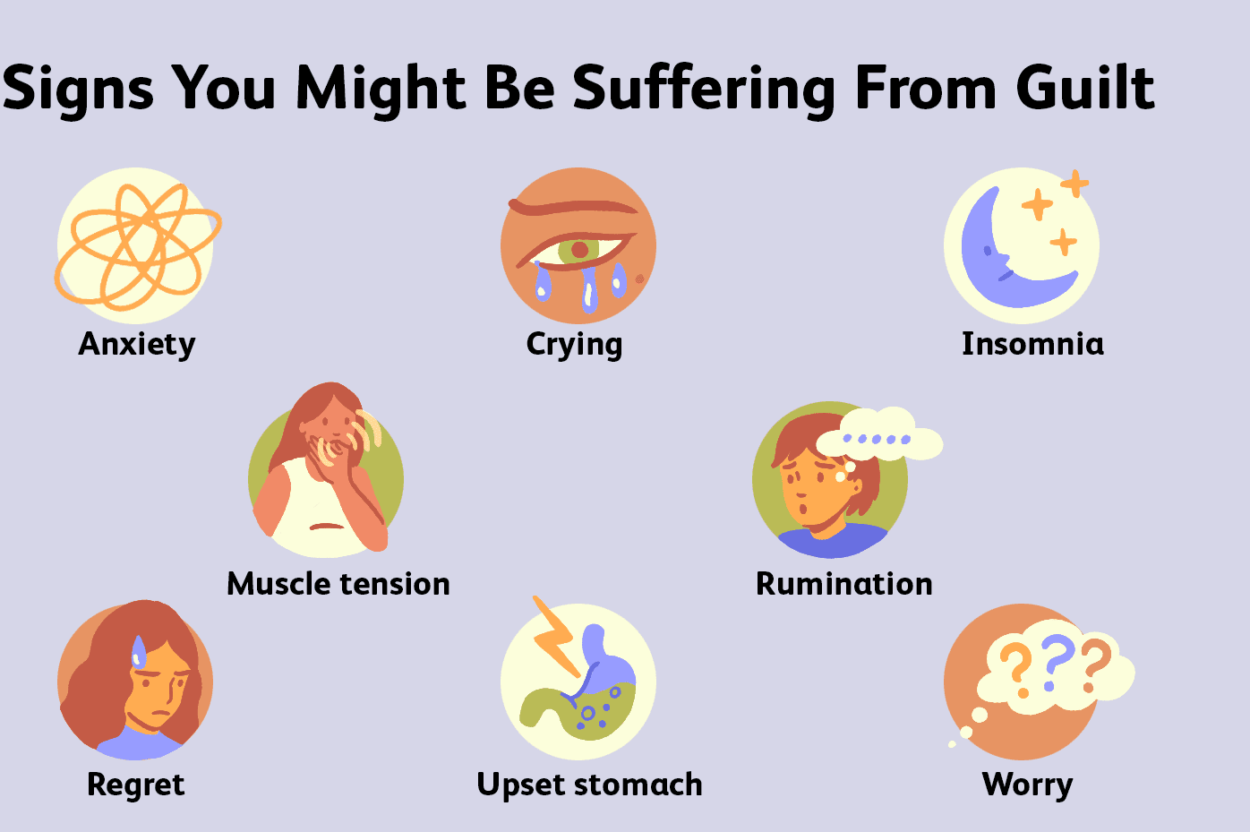
Guilt: Various Theories

Slide 16
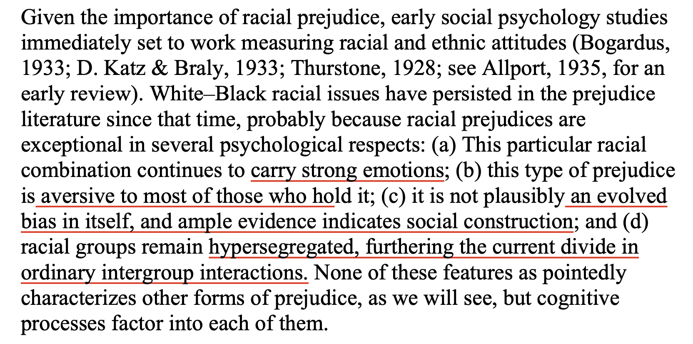
Racial Prejudice is Emotionally Complicated

Slide 17
Anti-Black Racism is Emotionally Loaded
most Whites’ emotionally loaded responses would better be described as shame
IAT: people have automatic stereotypic thoughts, which are difficult to control
Salient social norms also motivate Whites to inhibit prejudice, to acknowledge discrimination, and to resist hostile jokes

Slide 18
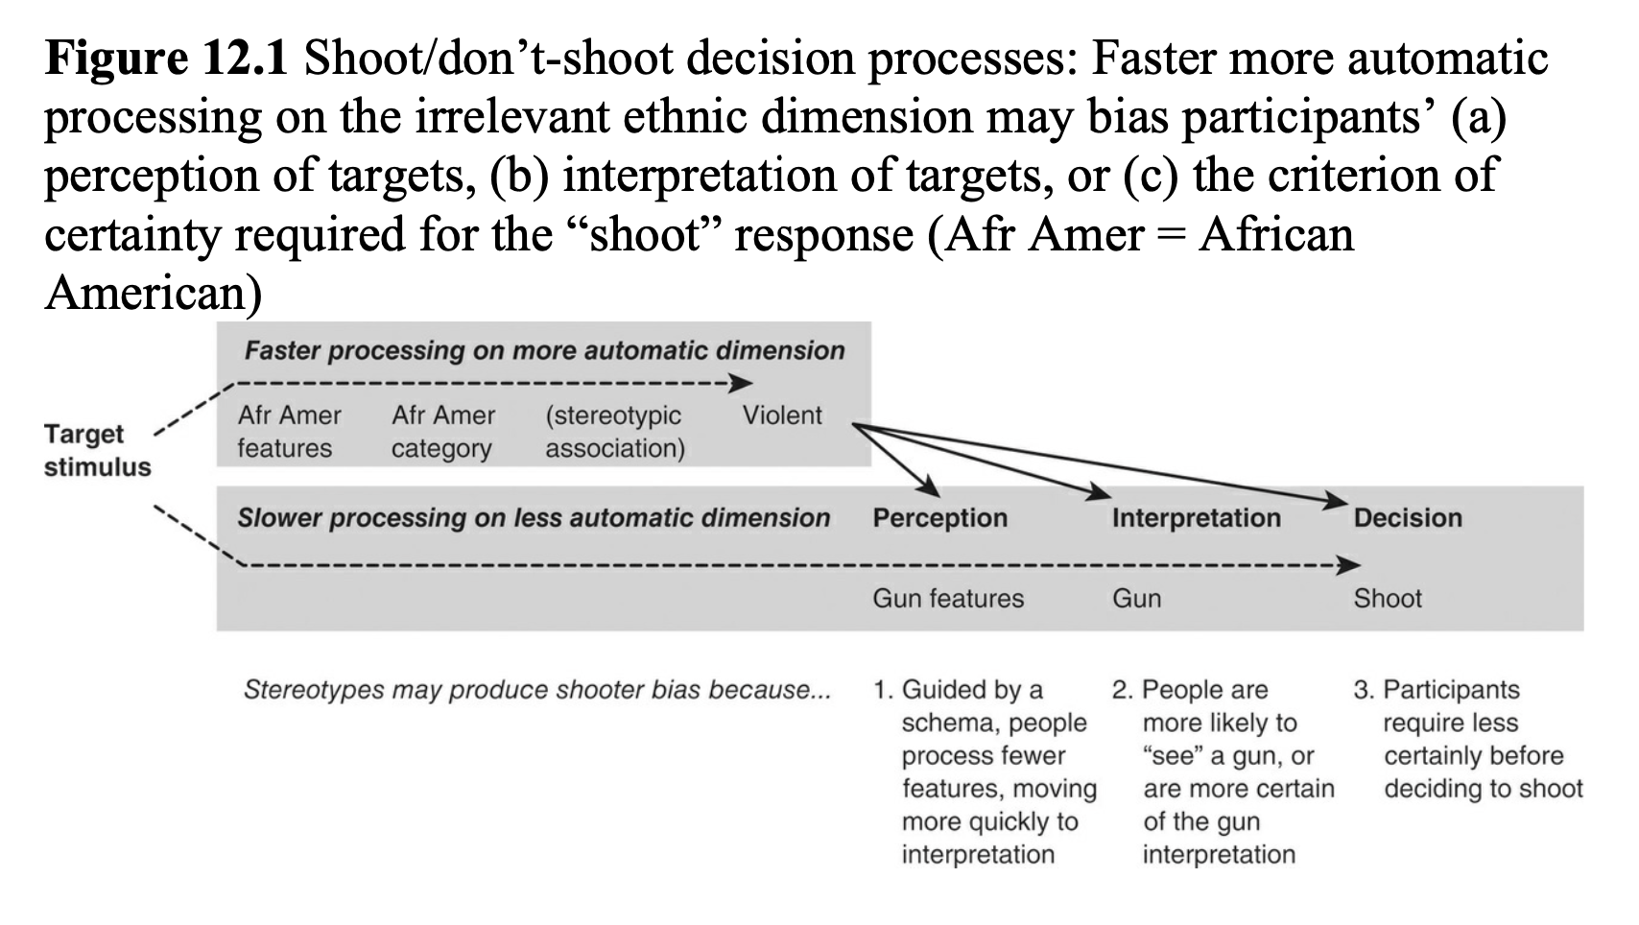

Slide 19
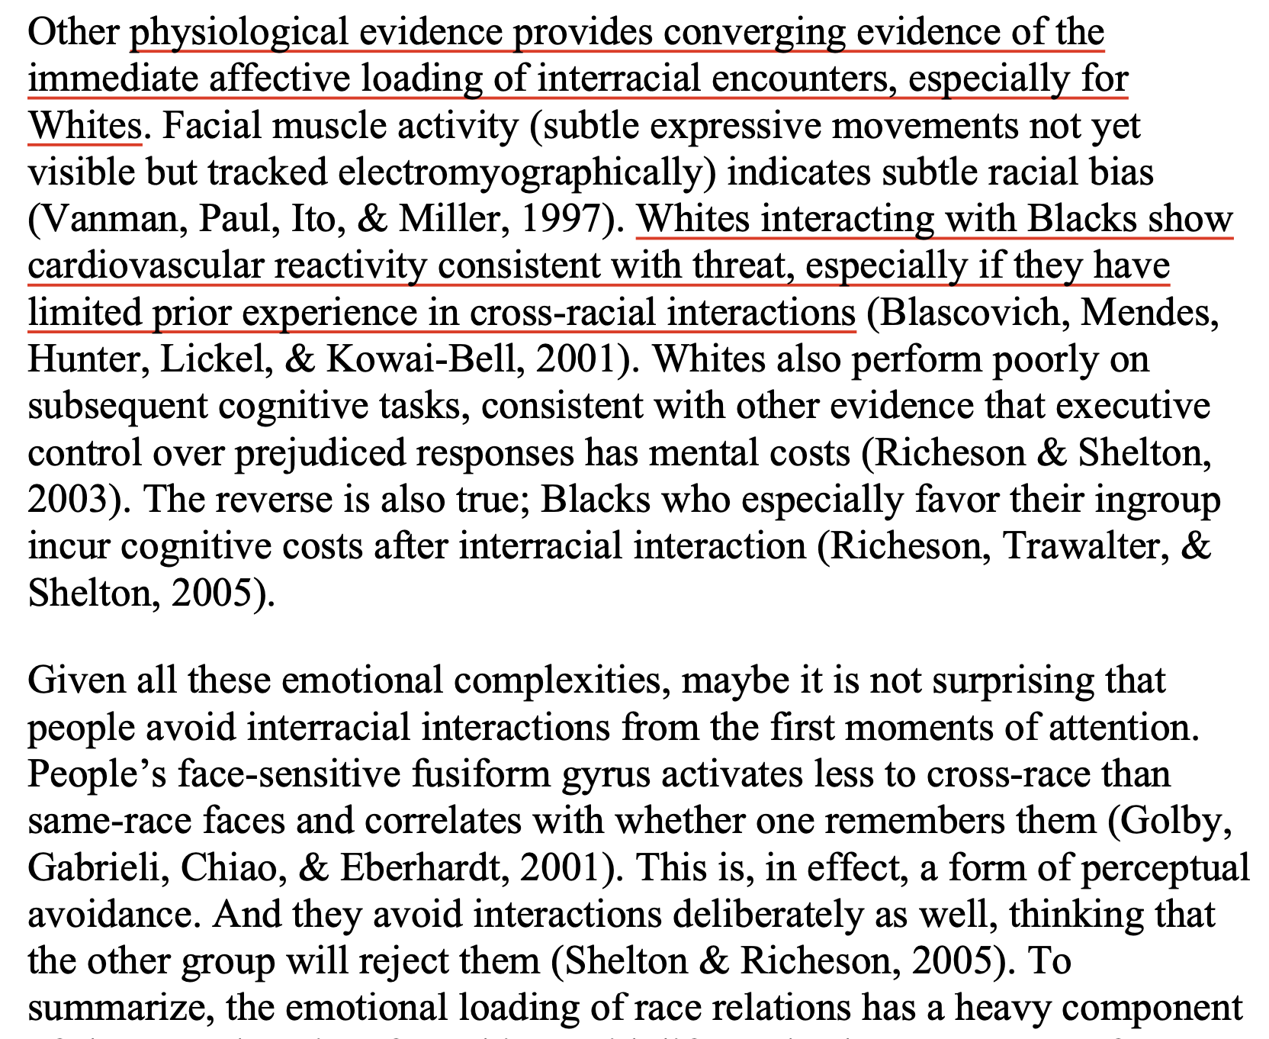

Slide 20
Much Racism is Aversive
Aversive racism reflects ambivalence that includes negative feelings and beliefs, coupled with paternalistic sympathy and denial of the negativity (Gaertner & Dovidio, 1986).
With regard to emotional prejudices, aversive racists show anxiety, discomfort, disgust, and fear
Racial Prejudice is Not Plausibly Evolved
People greatly exaggerate the biology of racial differences
dearth of biological evidence validating the genetics of racial
lack of evidence for an evolutionary predisposition to encode race automatically

Slide 21
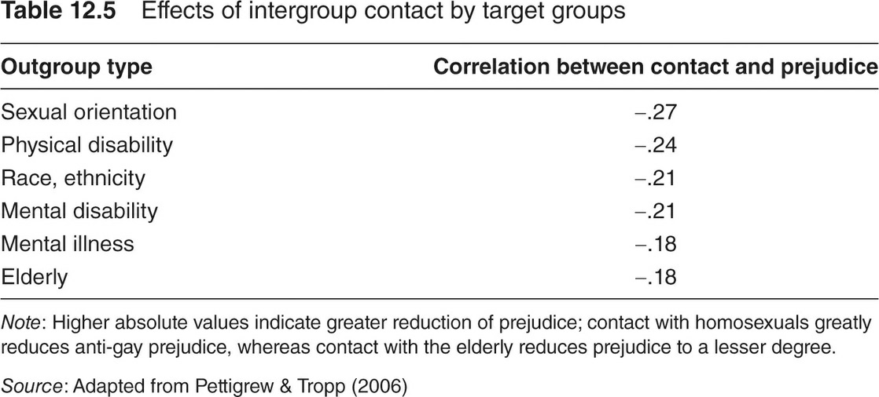
Segregation
equal-status intergroup contact
The effects of contact on prejudice especially operate for exposing White Americans to Black Americans, rather than vice versa, given their respective majority–minority status

Slide 22
Gender Prejudice has Built-in Ambivalence
(a) men’s and women’s unique structural relationships of heterosexual interdependence and male power in society,
(b) the resulting mixed, prescriptive stereotypes and ambivalent prejudices,
(c) biological and social bases of gender prejudice.

Slide 23
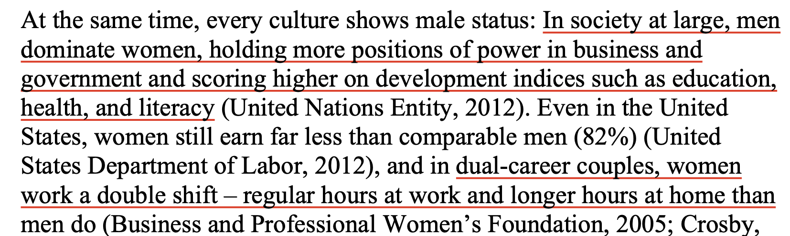
Intimate Interdependence and Male Status

Slide 24
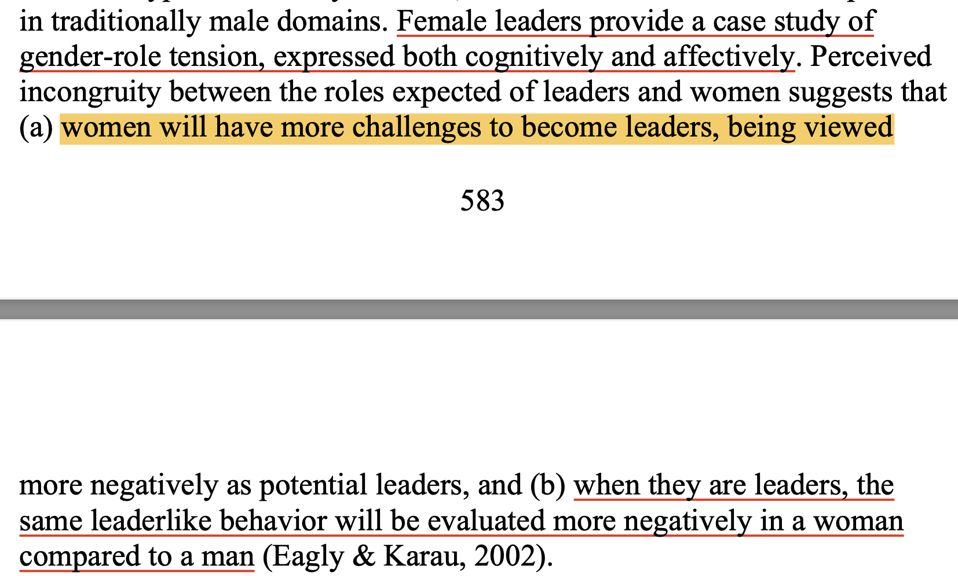

Slide 25
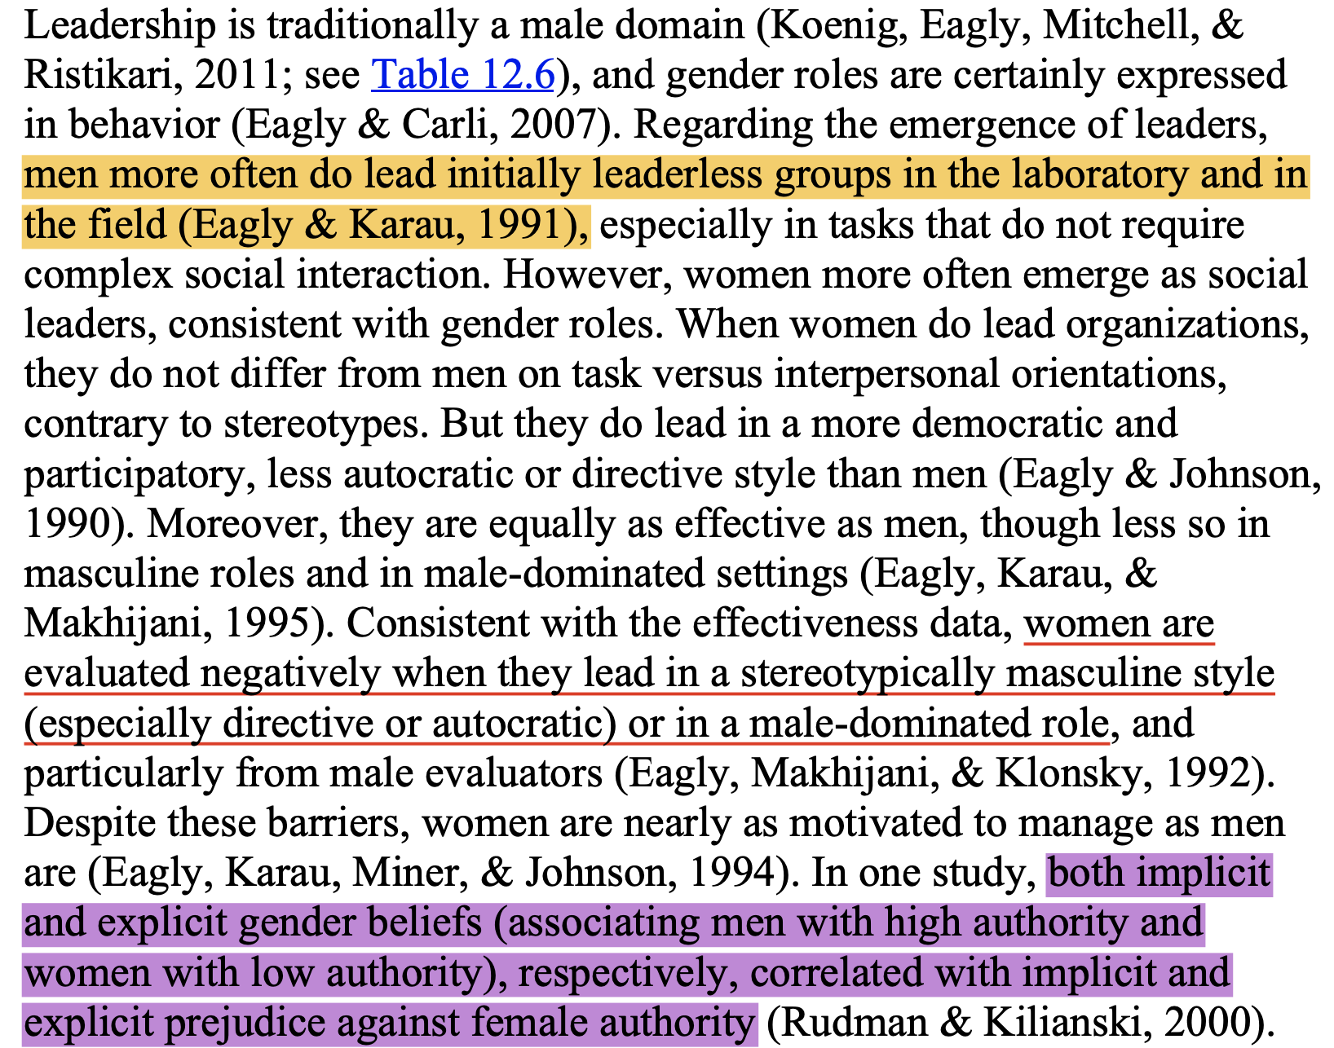
role congruity theory

Slide 26
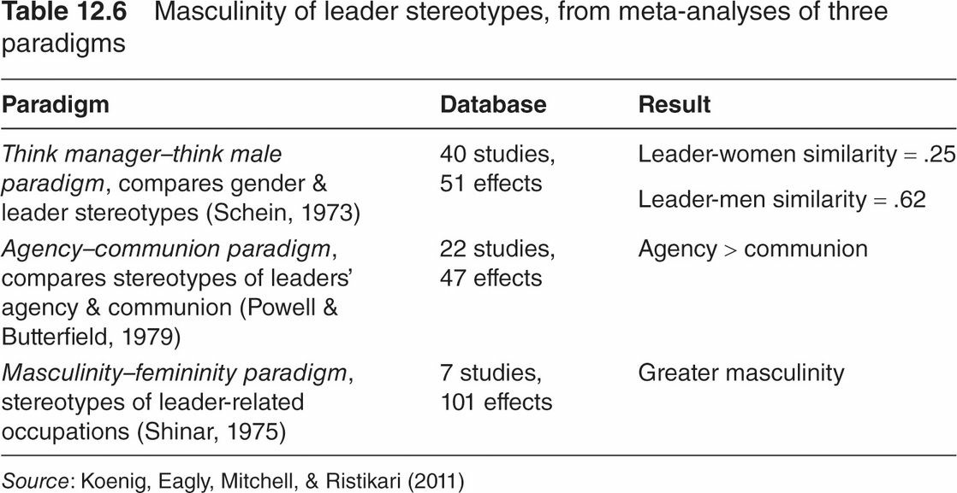

Slide 27
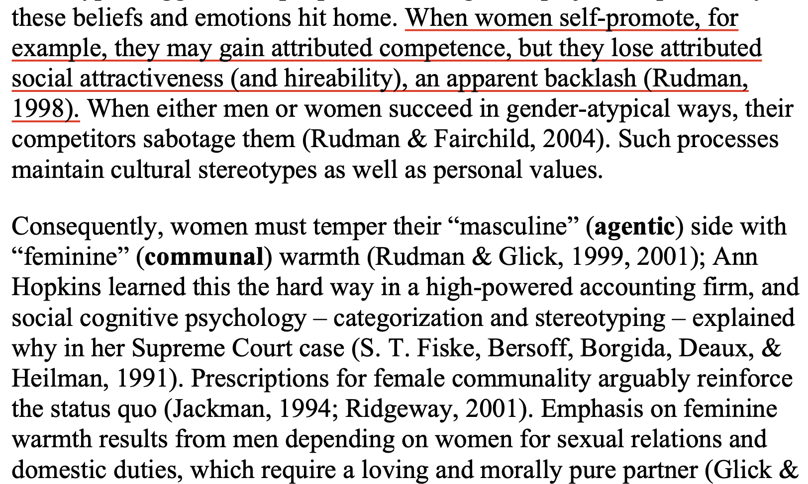
Emotionally Mixed, Prescriptive Stereotypes and Ambivalent Prejudices

Slide 28
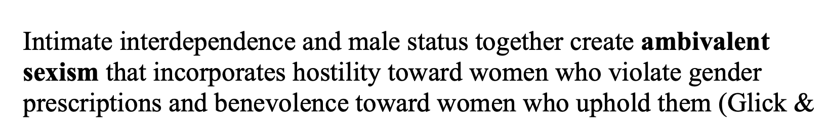
Ambivalent Sexism
Hostile and benevolent sexism are correlated, but they have distinct meanings. BS predicts positive (likable, moral) stereotypes of traditional women, and HS predicts negative (cold, untrustworthy) stereotypes of nontraditional women, reflecting the fundamental ambivalence.
Ambivalent sexism has consequences

Slide 29
Biological and Social Bases of Gender Prejudice
Women do indeed weigh social class and ambition higher than do men, who weigh attractiveness higher than do women
Social role theory also addresses gender differences in social behavior
biosocial approach acknowledges biological differences in average size and parental investment

Slide 30
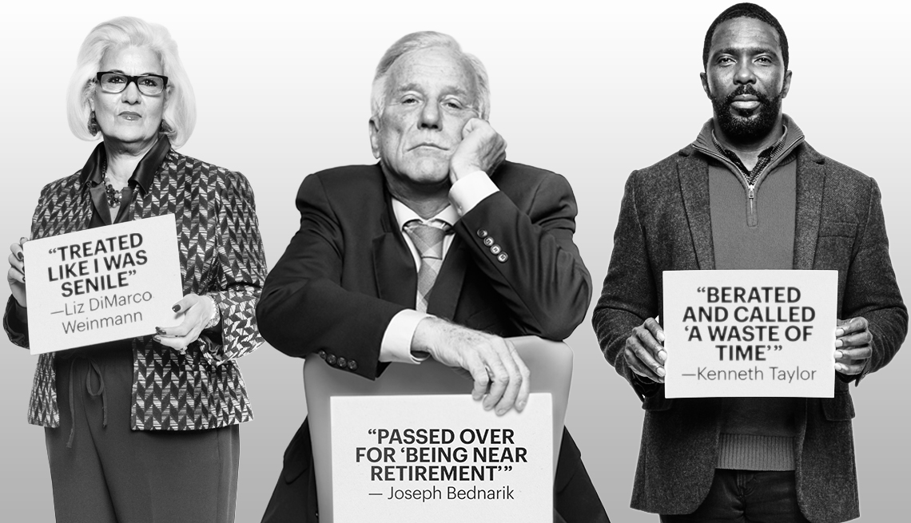
Age Prejudice Awaits All of Us

Slide 31
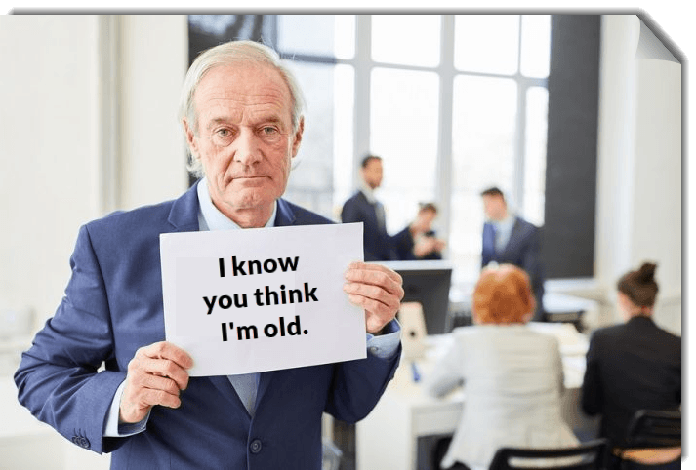
Ageism is unique in several respects.
Malleable Boundaries
Mortality and Terror Management

Slide 32
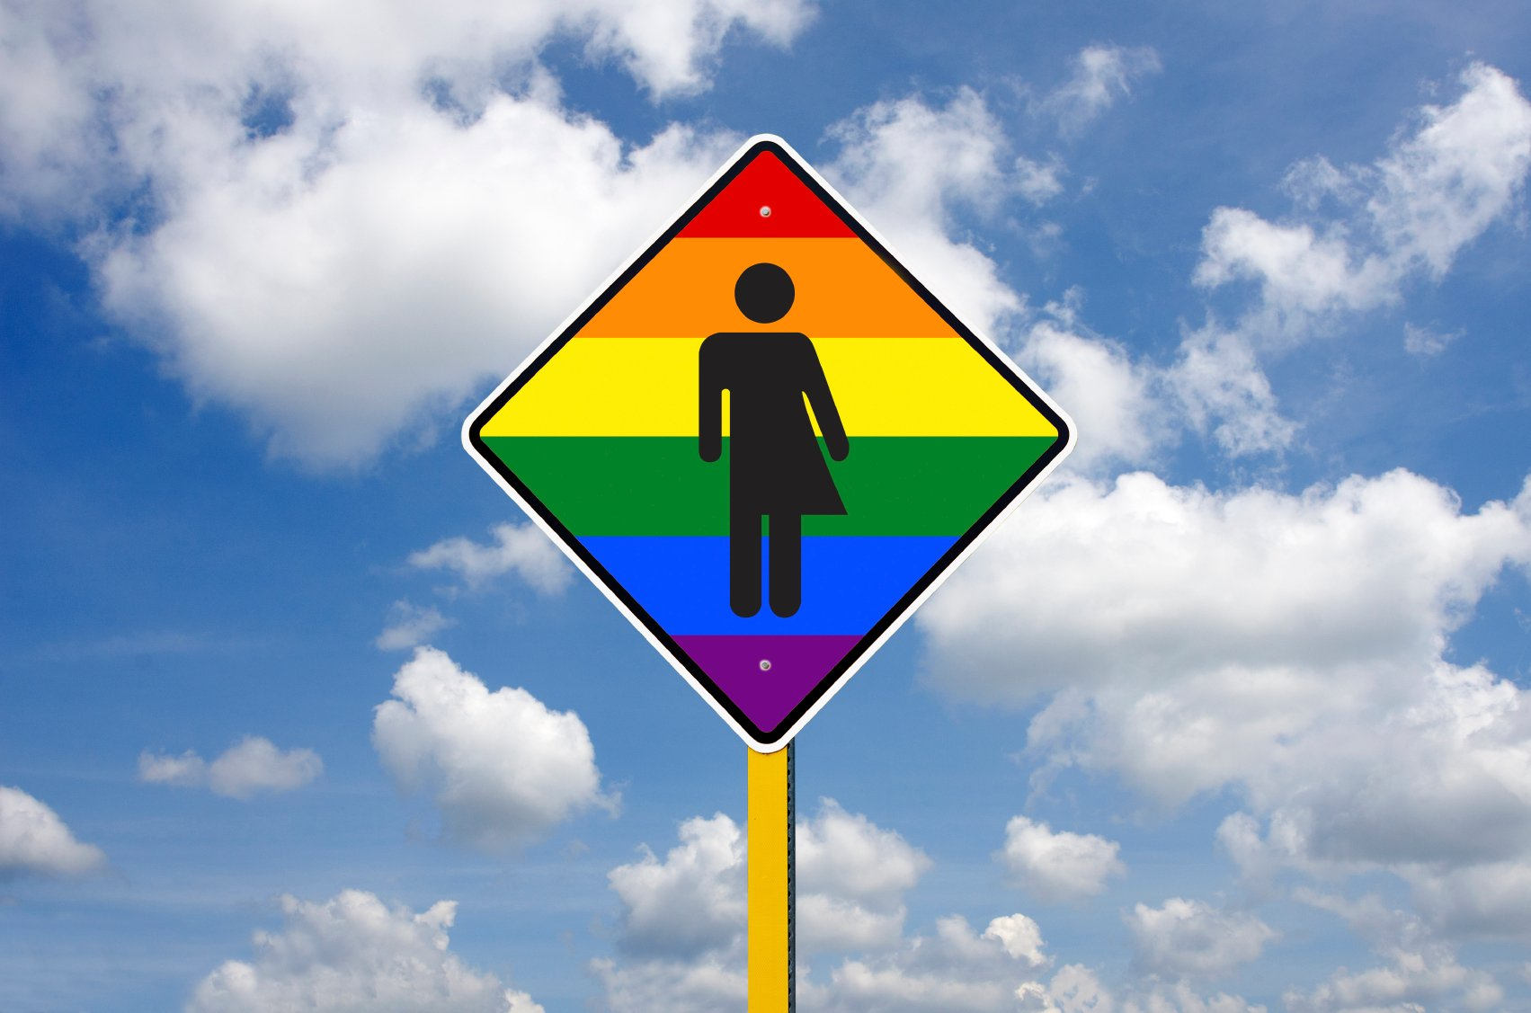
Sexual Prejudice is Controversial
Prejudice against gay men and lesbians, which goes by the names heterosexism, homophobia, and sexual prejudice, differs from other prejudices in at least three primary respects.
Hate crimes have targeted a fifth of lesbians and a quarter of gay men, resulting in depression, anger, anxiety, and stress, more than for comparable crime victims (Herek, Gillis, & Cogan, 1999).

Slide 33
Summary
emotional prejudices and their interplay with cognitions on which they are based;
specific ingroup–outgroup prejudices reflect the unique circumstances of different groups, the chapter examines four specific kinds of prejudice;
Gender prejudice uniquely combines high status for one group with interdependence between the two groups;
Ageism uniquely involves a moving target, in that people both hope and fear to join the outgroup category;
sexual prejudice targets a concealable stigma, but it is widespread and simultaneously controversial, evoking strong reactions on all sides.

